Slide 1

Deployability of Content-Centric Networking
Group 3 :
Mani Prashanth Varma Manthena (4243846)
Michal Golinski (4253590)
Dr. ir. Fernando Kuipers
Niels van Adrichem
(Network Architectures and Services Group)
1
Delft University of Technology
Challenge the future

Slide 2
Introduction
TCP/IP (host based communication model) vs. CCN (content-centric networking)
Problem description :
Deployability considerations of CCN like content to cache, cache size, caching under changing link conditions, etc.
To compare CCN performance with present TCP/IP architecture under various simulated real world scenarios.
Titel van de presentatie 2
ET4169 - Microwaves, Radar and Remote Sensing Nov 2012 - Jan 2
2013

Slide 3
Outline
Related work
The Project CCNx
Measurement scenario
Measurement results
Conclusion and future work
Titel van de presentatie 2
ET4169 - Microwaves, Radar and Remote Sensing Nov 2012 - Jan 2
2013

Slide 4
Related work
Cache size implementation and memory management of CCN based on various aspects like memory blocks price, efficiency of memory storage and buffering, amount of traffic in the network, etc.
Performance comparison of CCN with TCP/IP e.g. data transfer efficiency comparison of CCN, HTTP and HTTPS – Van Jacobson (2009).
Performance comparison of CCN with TCP/IP for various real time services and applications like live streaming, audio and video distribution, etc.
Titel van de presentatie 2
ET4169 - Microwaves, Radar and Remote Sensing Nov 2012 - Jan 2
2013

Slide 5
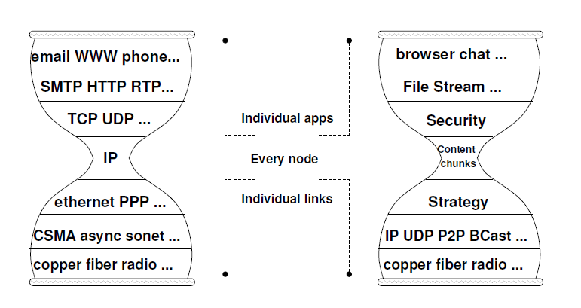
The Project CCNx
Introduction
Comparison of IP and CCN protocol stack
CCN packet types – interest and data
CCN content naming – hierarchical structure
figure: Van Jacobson (2009)
Titel van de presentatie 2
ET4169 - Microwaves, Radar and Remote Sensing Nov 2012 - Jan 2
2013

Slide 6
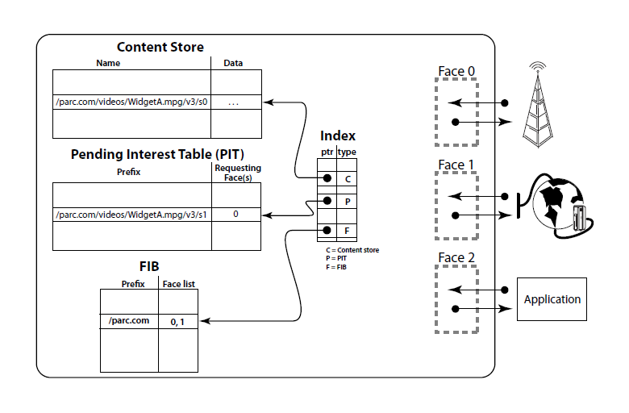
CCN forwarding engine model
Project CCNx allows users to change several CCN protocol parameters like cache size, MTU size, etc. in the protocol open source configure file.
figure: Van Jacobson (2009)
Titel van de presentatie 2
ET4169 - Microwaves, Radar and Remote Sensing Nov 2012 - Jan 2
2013

Slide 7
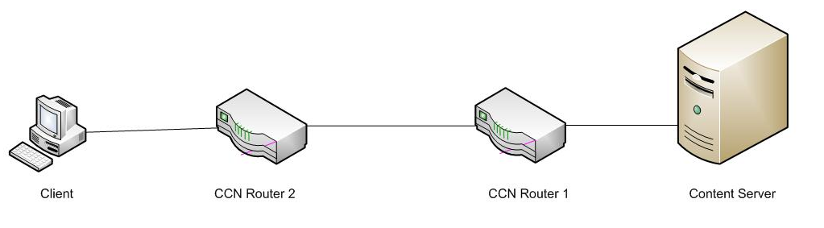
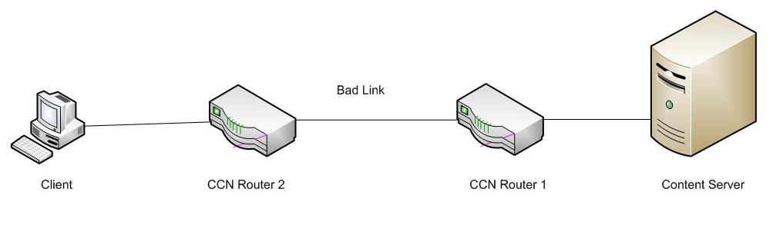
Measurement scenario
Measurement setup – A
Measurement setup - B
Titel van de presentatie 2
ET4169 - Microwaves, Radar and Remote Sensing Nov 2012 - Jan 2
2013

Slide 8
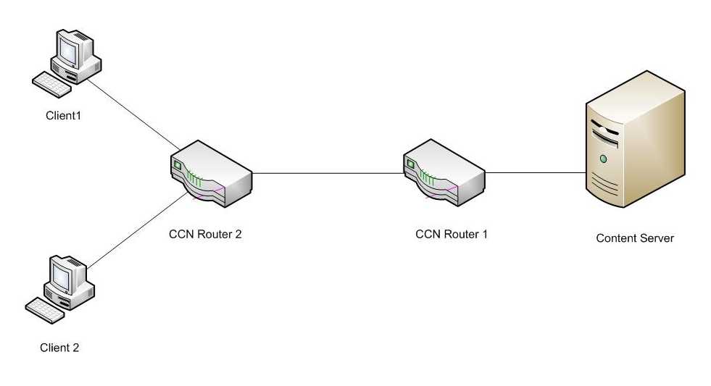
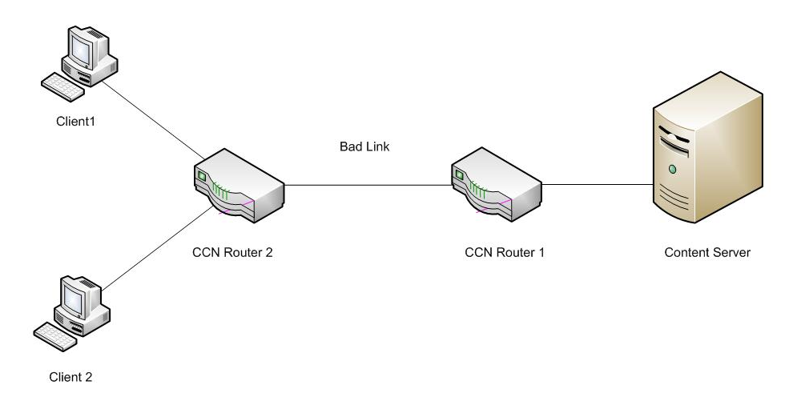
Measurement setup – C
Measurement setup - D
Titel van de presentatie 2
ET4169 - Microwaves, Radar and Remote Sensing Nov 2012 - Jan 2
2013

Slide 9
Problems encountered – delay measurements, hardware configuration, MTU not responding
Expected results
Larger cache sizes would decrease overall delay, jitter, etc. in measurement setups C and D.
CCN would out perform HTTP in measurement setups C and D and would approximately match the performance of HTTP in other setups and scenarios.
MTU size could fix the problem of decrease of bandwidth.
CCN could handle packet losses like TCP/IP.
Titel van de presentatie 2
ET4169 - Microwaves, Radar and Remote Sensing Nov 2012 - Jan 2
2013

Slide 10
Measurement results
Influence of cache size on delay
Mean packet delays
Titel van de presentatie 2
ET4169 - Microwaves, Radar and Remote Sensing Nov 2012 - Jan 2
2013

Slide 11
Standard deviation of packet delays (jitter)
Titel van de presentatie 2
ET4169 - Microwaves, Radar and Remote Sensing Nov 2012 - Jan 2
2013

Slide 12
Influence of delay on a bandwidth
Bandwidth of file download (logarithmic scale)
Titel van de presentatie 2
ET4169 - Microwaves, Radar and Remote Sensing Nov 2012 - Jan 2
2013

Slide 13
Relative bandwidth loss
Titel van de presentatie 2
ET4169 - Microwaves, Radar and Remote Sensing Nov 2012 - Jan 2
2013

Slide 14
Achieved CCN bandwidths
Titel van de presentatie 2
ET4169 - Microwaves, Radar and Remote Sensing Nov 2012 - Jan 2
2013

Slide 15
MTU (Maximum Transmission Unit) size and download time
Titel van de presentatie 2
ET4169 - Microwaves, Radar and Remote Sensing Nov 2012 - Jan 2
2013

Slide 16
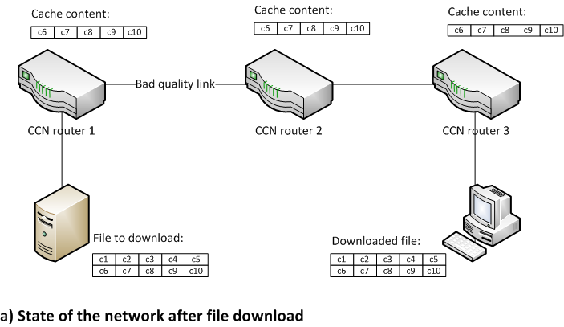
Smart caching strategies
Titel van de presentatie 2
ET4169 - Microwaves, Radar and Remote Sensing Nov 2012 - Jan 2
2013

Slide 17
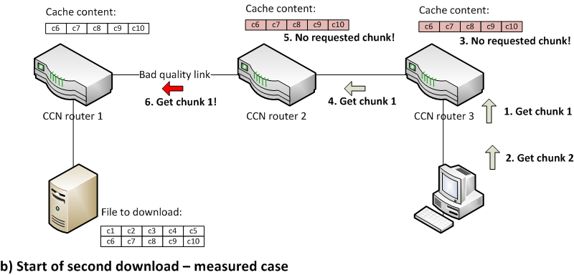
Smart caching strategies
Titel van de presentatie 2
ET4169 - Microwaves, Radar and Remote Sensing Nov 2012 - Jan 2
2013

Slide 18
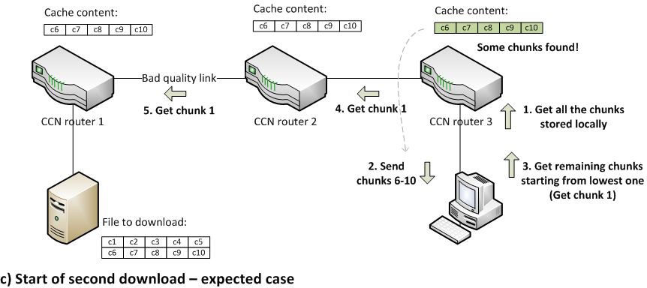
Smart caching strategies
Titel van de presentatie 2
ET4169 - Microwaves, Radar and Remote Sensing Nov 2012 - Jan 2
2013

Slide 19
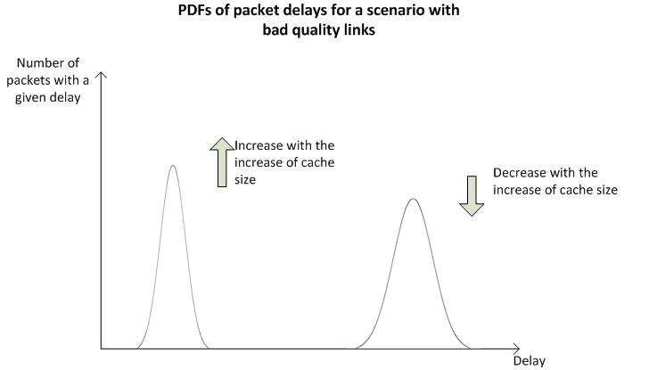
Packet delays in a scenario of smart caching
Links with losses
CCN network was unable to handle the file download
Strategy layer of CCNx does not implement handling of packet losses
Titel van de presentatie 2
ET4169 - Microwaves, Radar and Remote Sensing Nov 2012 - Jan 2
2013

Slide 20
Conclusion and future work
Our results showed some loopholes in the present implementation of CCNx like poor caching strategy, unable to handle packet losses and implementation flaws in MTU size.
For most of the real world scenarios, HTTP still has better performance compared to CCN, but CCN proved to outperform HTTP in the case of large cache sizes and multiple users/hosts requesting the same content data.
We also proposed smart caching strategies and other implementation changes required in the present CCNx.
Titel van de presentatie 2
ET4169 - Microwaves, Radar and Remote Sensing Nov 2012 - Jan 2
2013

Slide 21
Our measurements were performed by simulating wide area network on a small scale network.
Such a simulation can not truly represent a wide area network like Internet where network traffic parameters change with time and space.
So, we would like to extend our measurements and test on more of a real world, wide area network (Internet) by using something like research test beds as in PlanetLab, as our future work.
Titel van de presentatie 2
ET4169 - Microwaves, Radar and Remote Sensing Nov 2012 - Jan 2
2013

